Slide 1
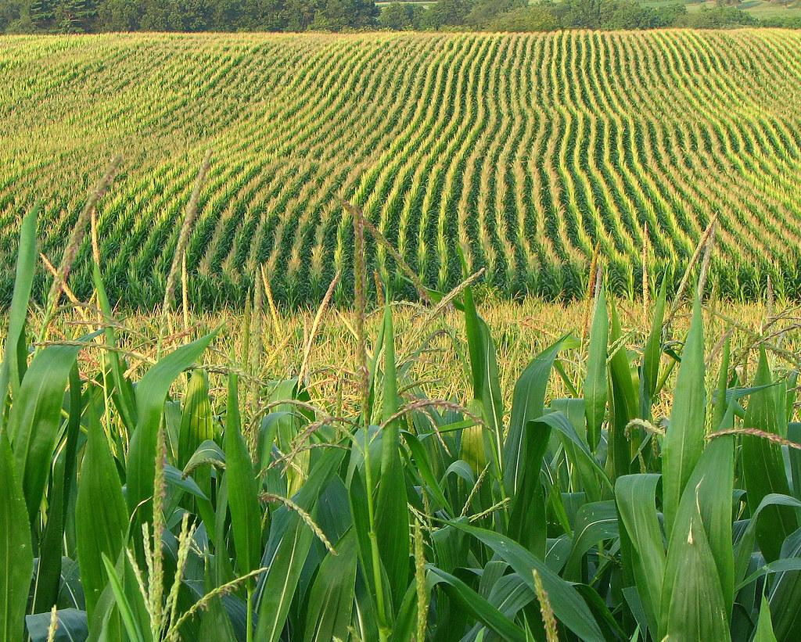
Team D: NiMo
Autonomous Nitrate Monitoring in Cornstalks
Project Management Methodology
Sruthi Mukkamala, Shara Lawande, Thomas Detlefsen, Shrudhi Ramesh Shanthi, and Saudamini Ghatge

Slide 2
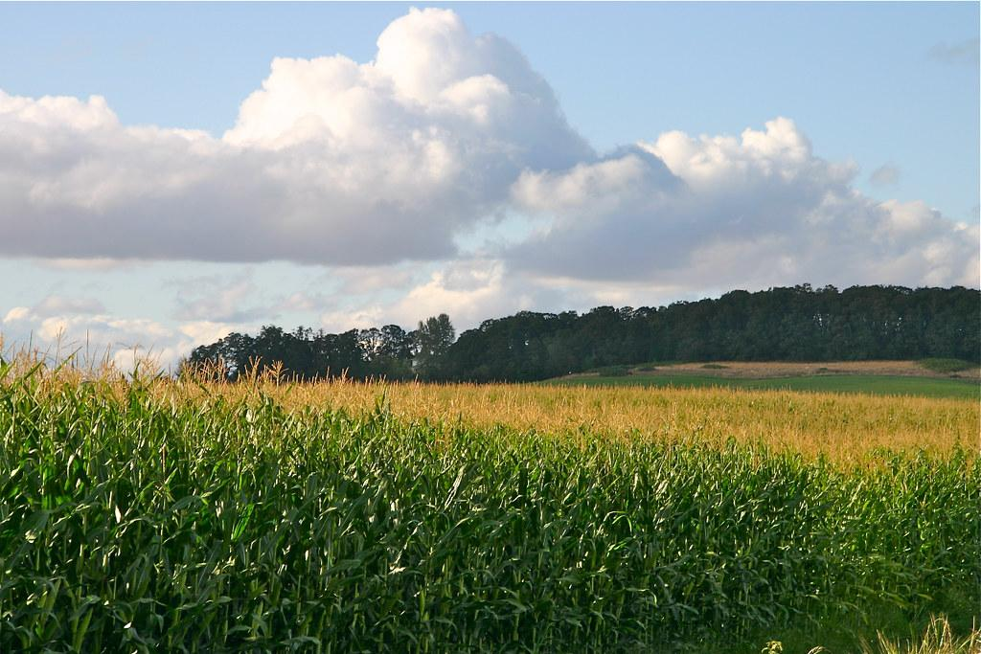
Project Description
Oregon Department of Agriculture
Notes:
Sauda

Slide 3
Overview
On average, American farmers use 130 - 140 lbs of nitrogen based fertilizer per acre.
The overuse of fertilizer causes wastage of fertilizer, increase in operational costs, and higher chances of environmental hazards
Only 40-60% of nitrogen is absorbed by crops annually by using the labor-intensive Corn Stalk Nitrate Test (CSNT), a seasonal test that cannot be used in droughts.
If farmers could have feedback on how much nitrogen is being absorbed by the corn, they could consistently achieve an optimal yield without over fertilizing.
Nitrogen Absorption Period
Planting
Fertilization
Nitrogen Loss
Nitrogen Testing
Harvest
Notes:
Based on our research last year we found out that on an avg an american farmer uses excessive amt of nitrogen based fertilizer, which leads to high operating costs and also higher risks of env hazards. Although only some amt of it is used by crops, which is concluded based upon the Corn Stalk Nitrate Test, which is a manual method of measuring nitrate levels in a cornstalk. If farmers had a feedback mechanism to understand how much nitrogen is being absorbed, then they could make optimal use of fertilizers without causing any harm to the environment.

Slide 4
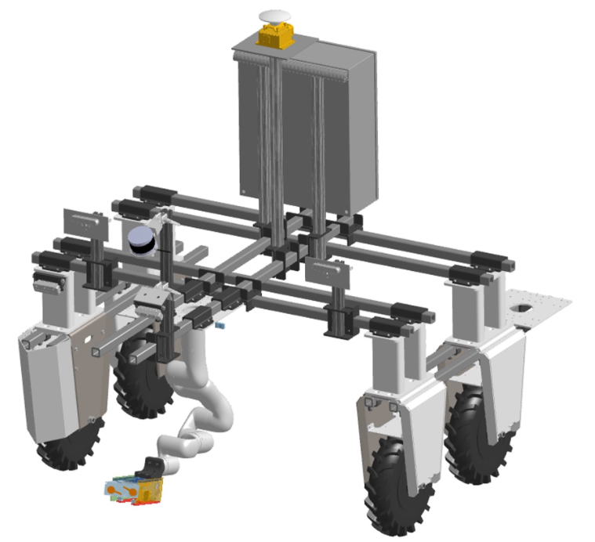
Project Goal:
Autonomous monitoring of nitrate levels in cornstalks, which will aid in giving feedback to the farmers on the amount of nitrogen to be used.
Solution:
A mobile robot with the capability to autonomously navigate through a field and inserting a nitrate sensor into the cornstalk to measure the level.
Notes:
So our motivation is based upon this problem statement, where we would like to provide a solution which can conduct these nitrogen tests on cornstalks, giving feedback to the farmers on how much fertilizer they should actually be using. So our solution is an autonomous mobile robot which can autonomously perform the tasks of navigating through the cornfield, inserting a nitrate sensor into the cornstalk along with handling the maintenance of this sensor.

Slide 5

Technical Development
Michigan Ag Council

Slide 6
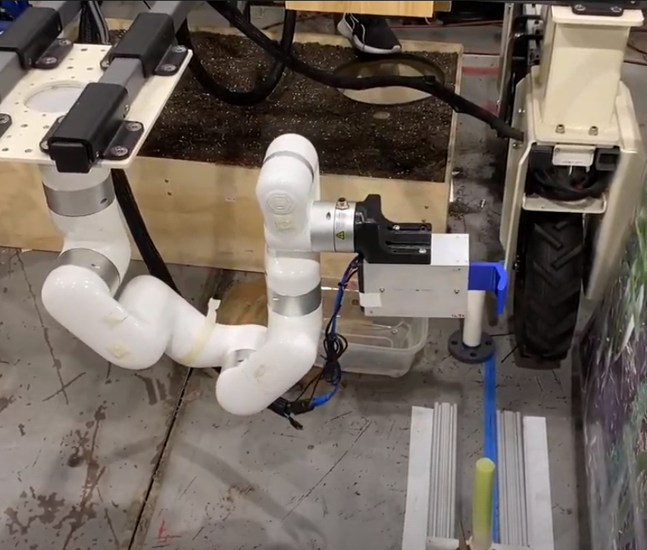
Manipulation
Status
Moves to identified cornstalk
Arcs around cornstalk
Grips cornstalk
Moves to External Mechanisms
Challenges
Singularities in trajectory for cornstalks closer to xArm base
Plans
Develop a local planner for xArm

Slide 7
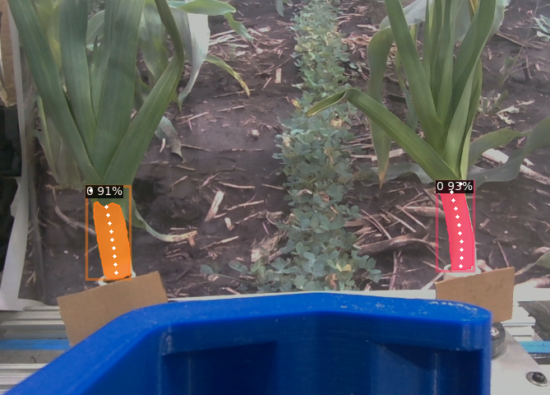
Perception
Status
Identifies valid cornstalks
Identifies the width of cornstalks
Challenges
Stalks were not perfectly aligned when gripping
Goals
Develop a method for visual servoing
Mask RCNN Detection w/ Feature Points

Slide 8
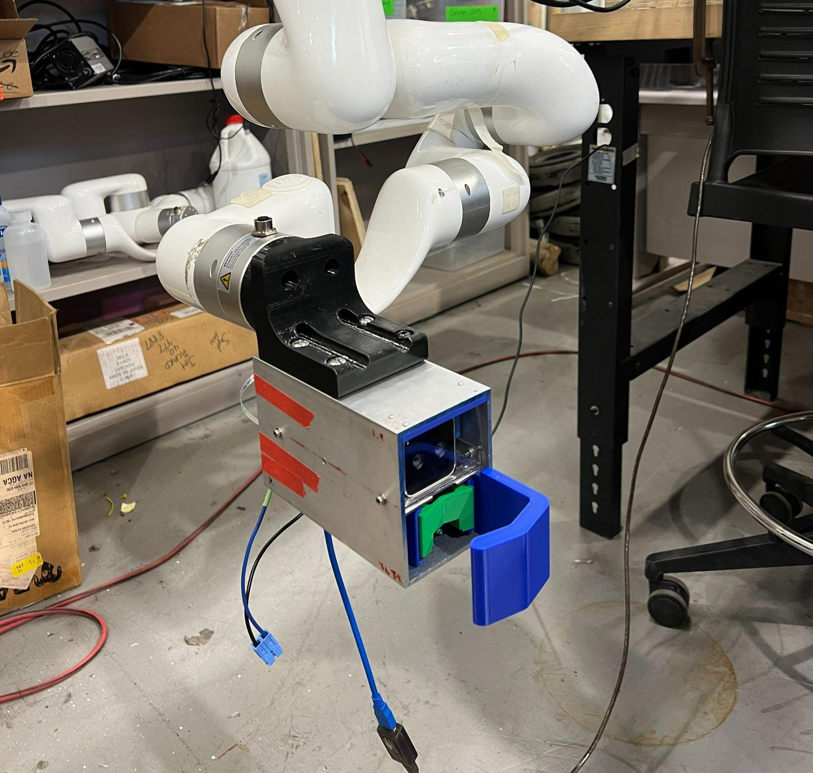
End Effector
Status
Grips the identified cornstalk (of suitable diameter)
Inserts nitrate sensor at minimum 9 mm into this cornstalk
Challenges
No Challenges
Goals
Stretch: Enable gripping + insertion for smaller diameter cornstalks
End Effector subsystem mounted on XArm

Slide 9
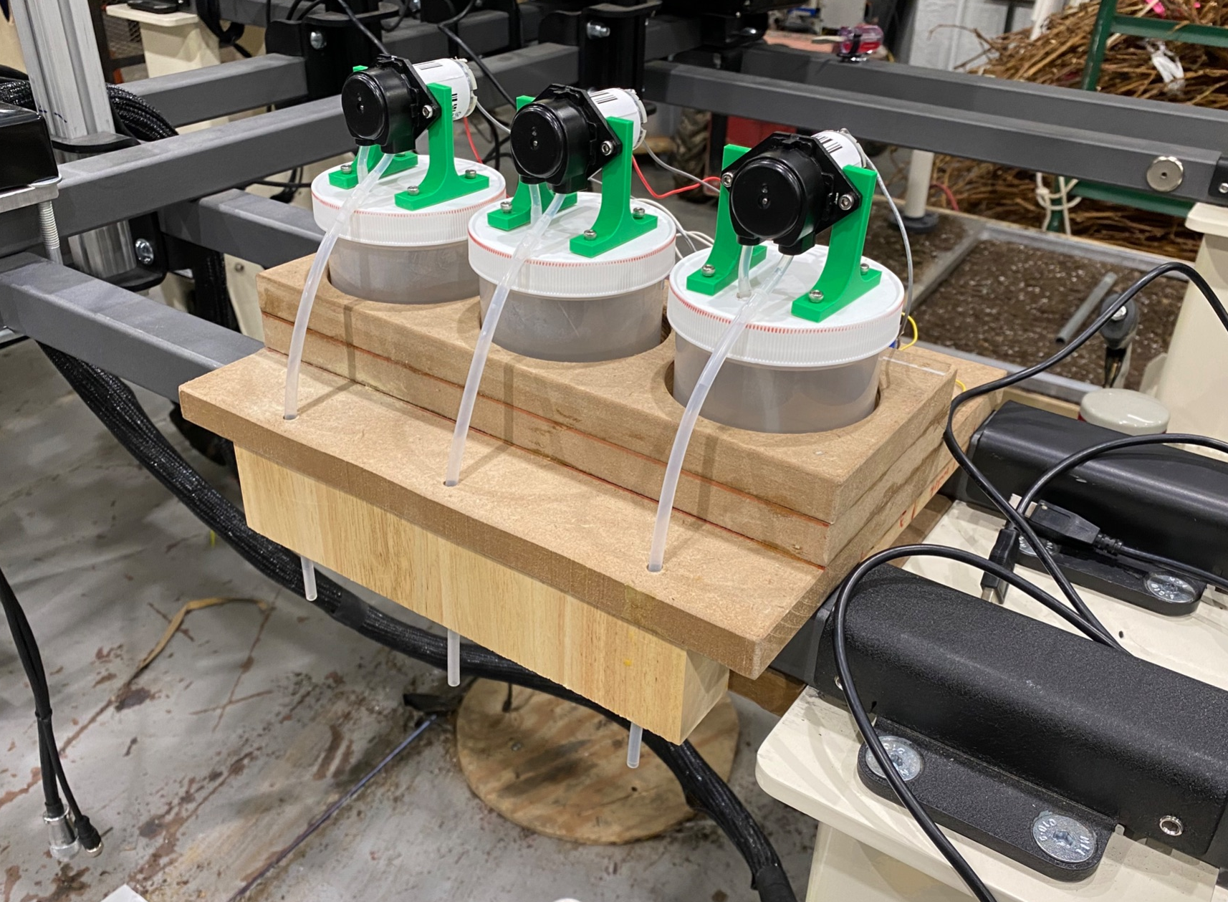
External Mechanisms
Status
Cleans and calibrates the sensor before insertions to produce valid sensor readings
Challenges
No challenges
Goals
System maintenance for FVD

Slide 10
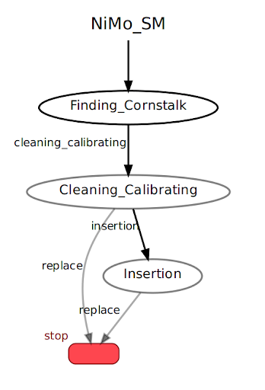
Finite State Machine
Status
Transitions between states while handling all the edge cases
Challenges
No Challenges
Goals
Integrating Navigation Subsystem with the FSM
Notes:
sauda

Slide 11
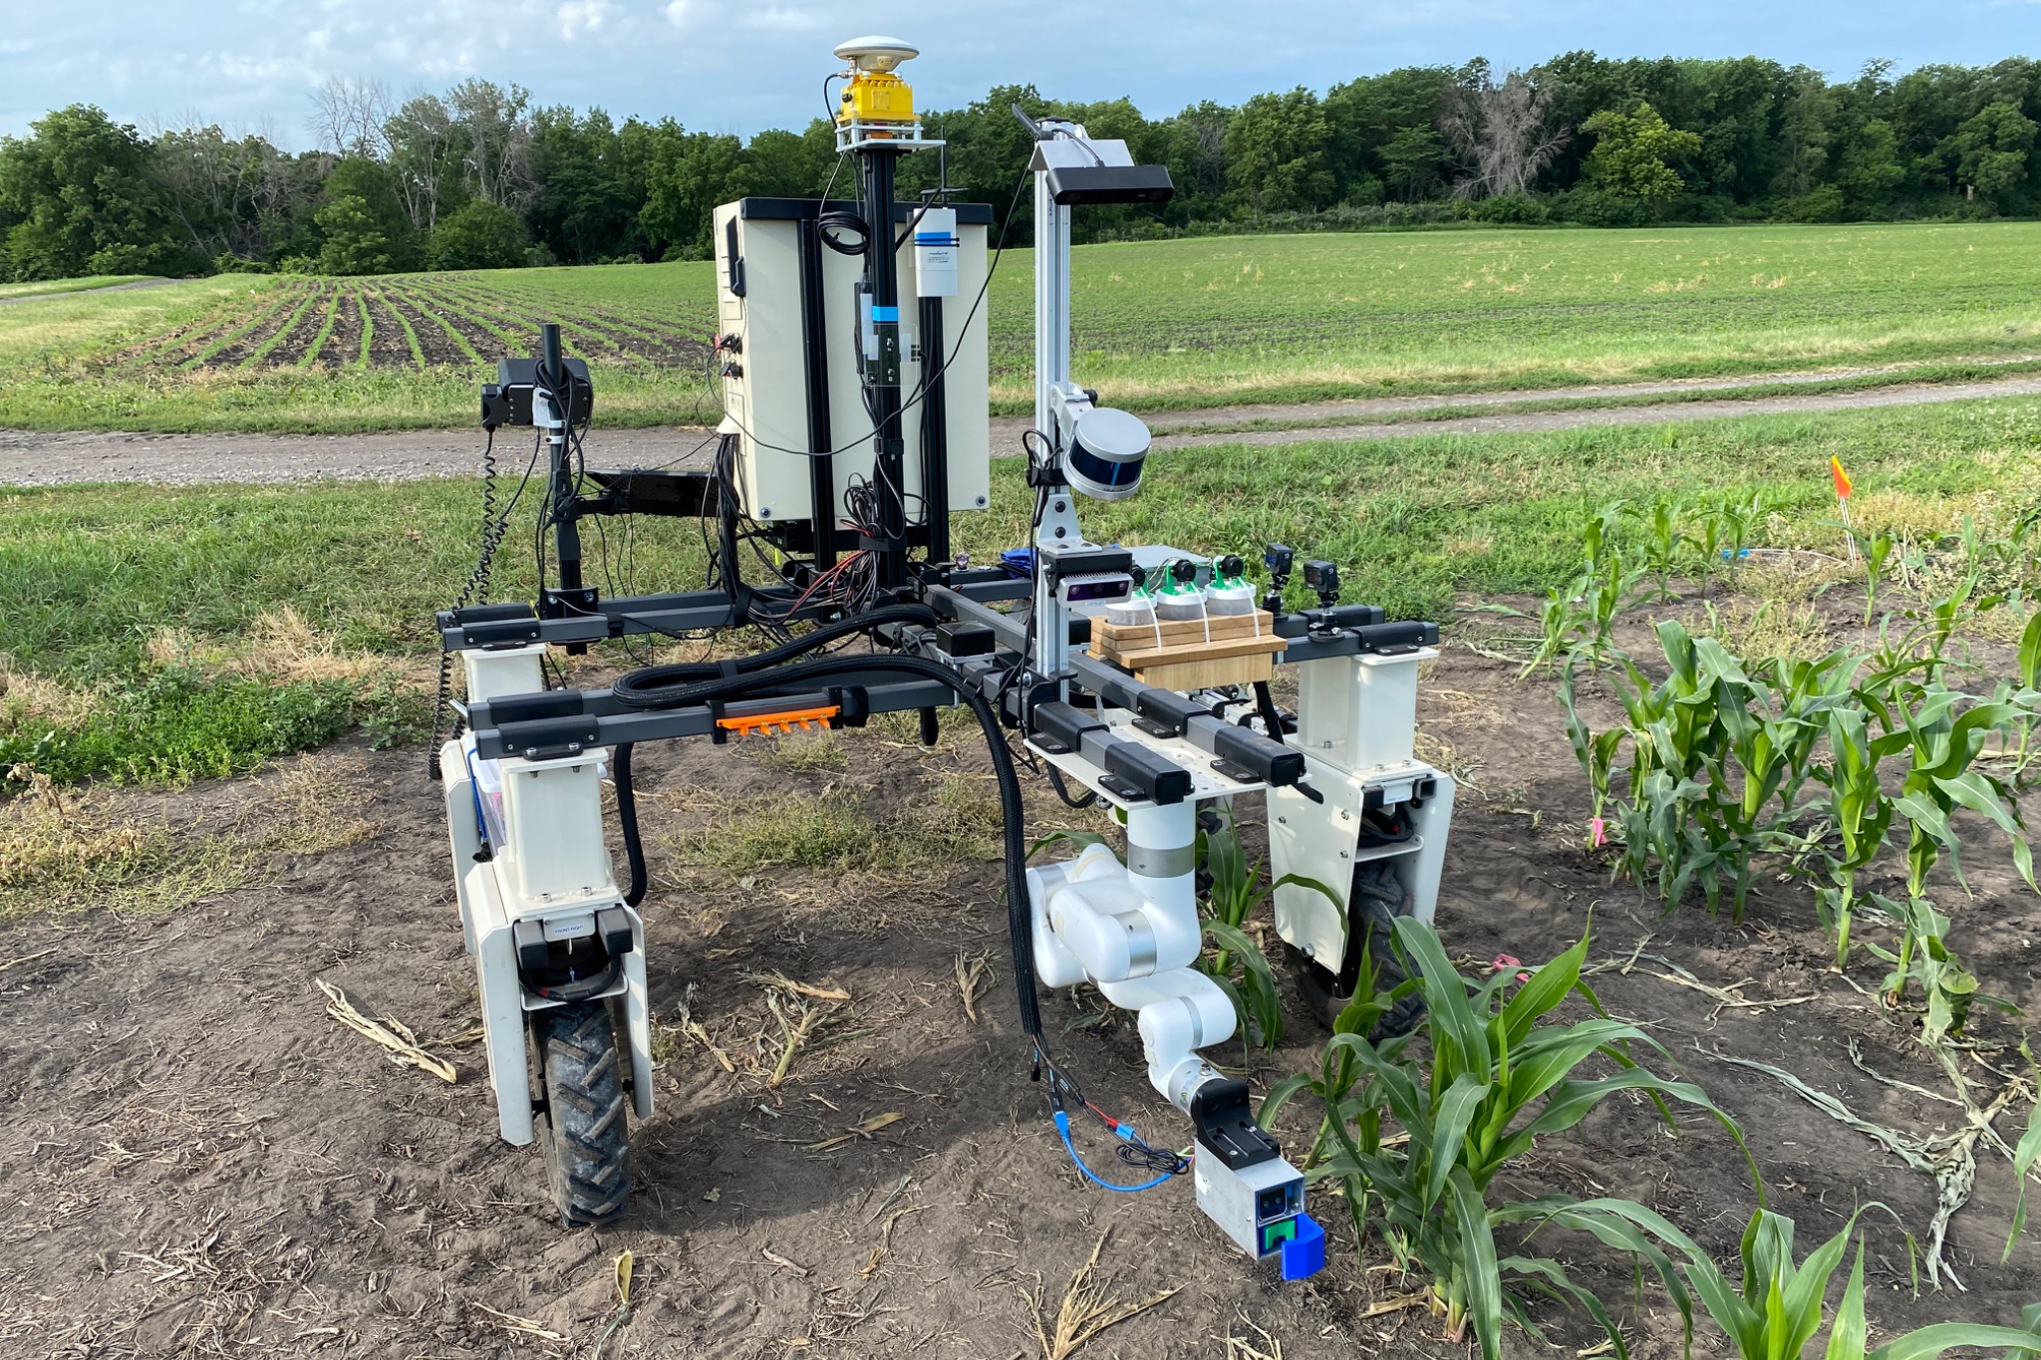
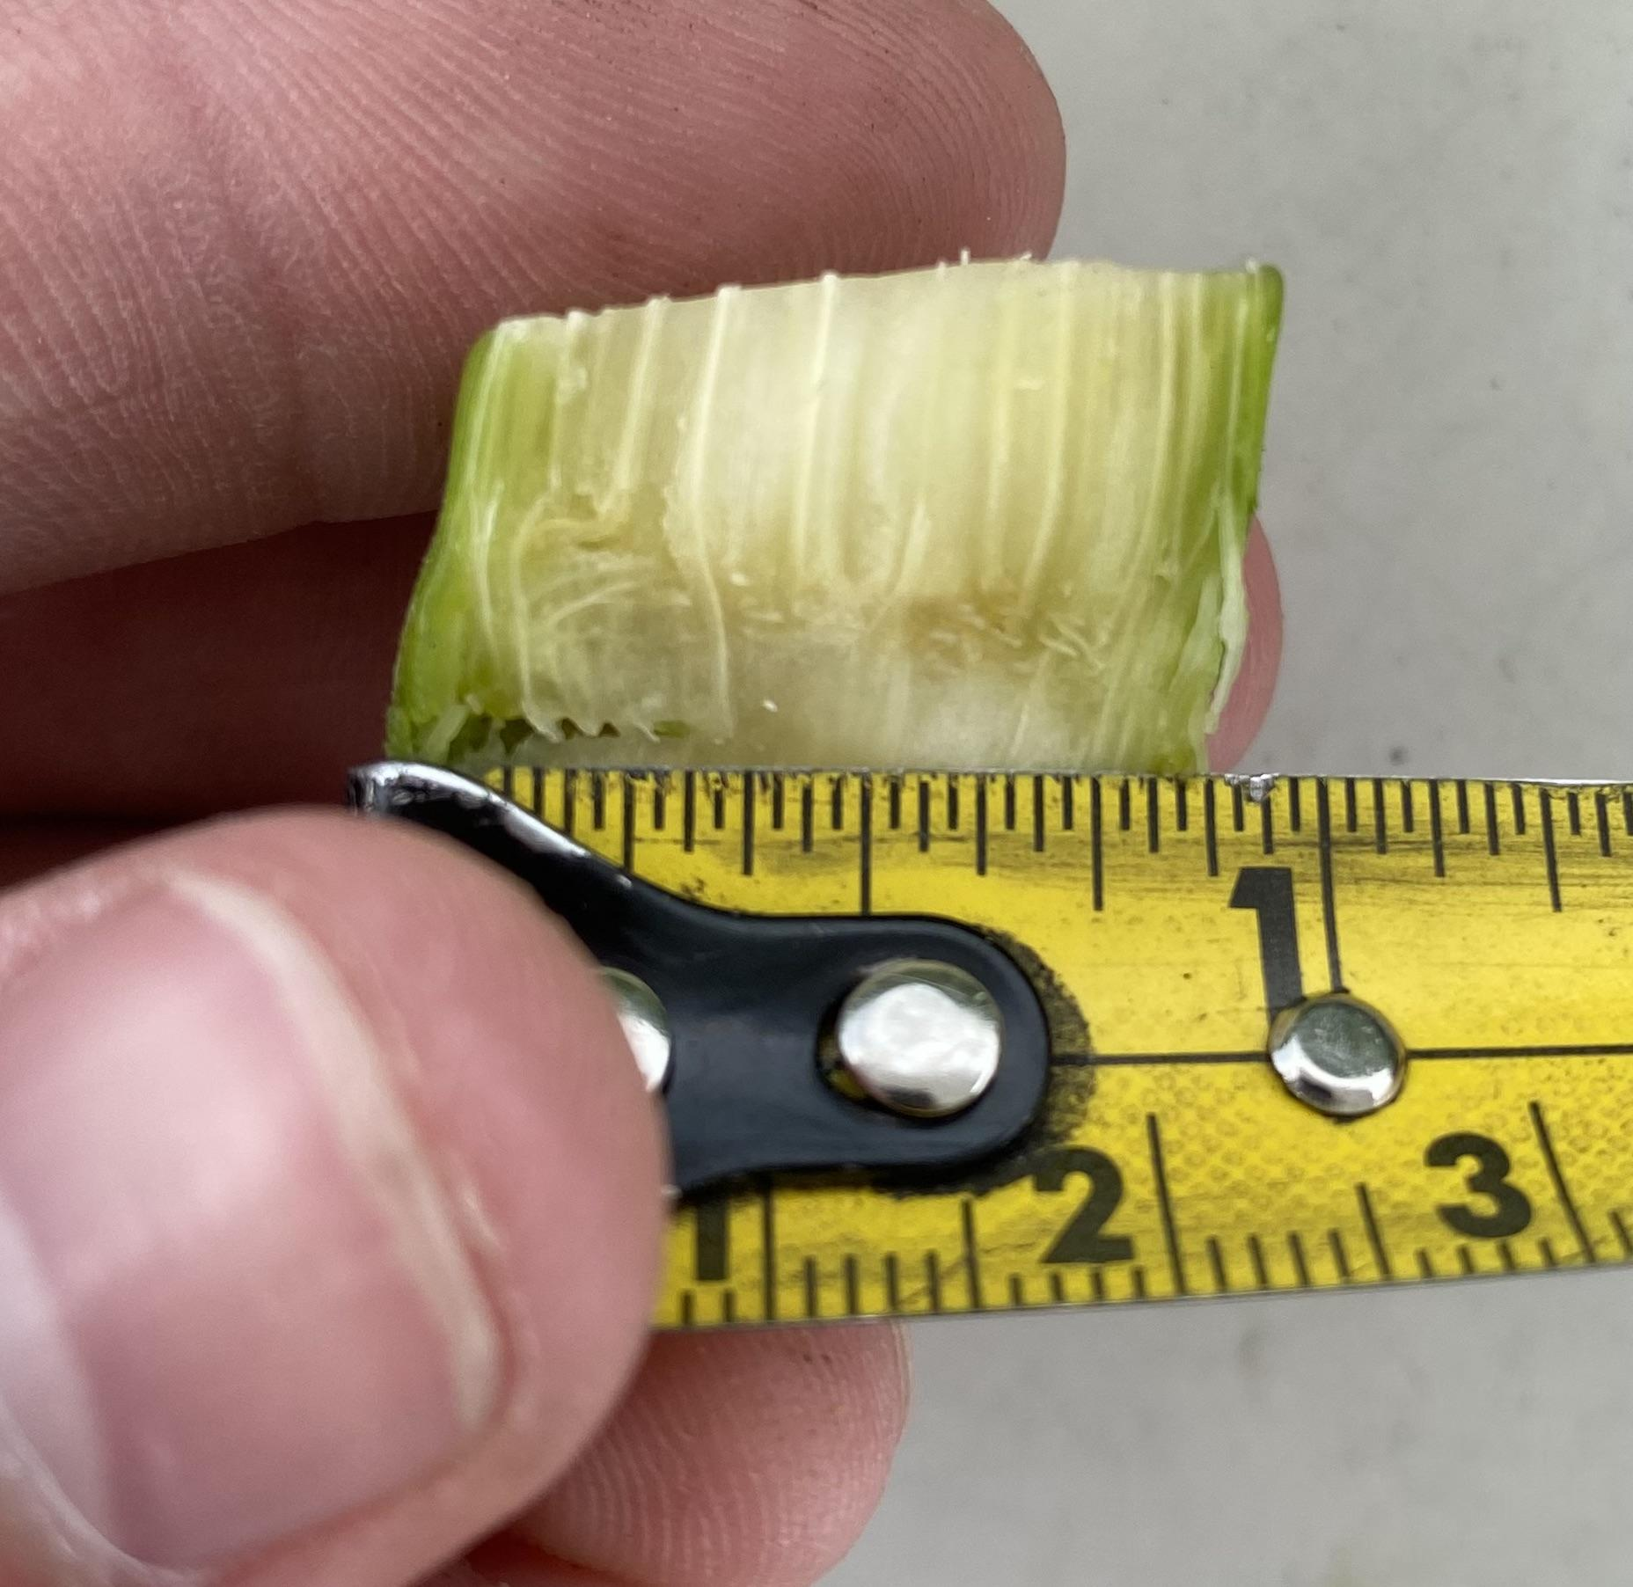
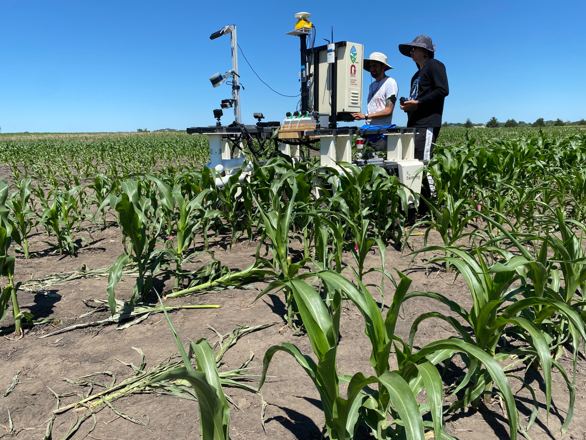
Summer Testing
Successes
System largely functioned as expected
Lessons
Cornstalks were taller and thinner than expected
Proper insertion point is lower than expected
Proper insertion in a real cornstalk
NiMo Platform in the field in Iowa
NiMo Platform in the field in Iowa
Notes:
Thomas

Slide 12
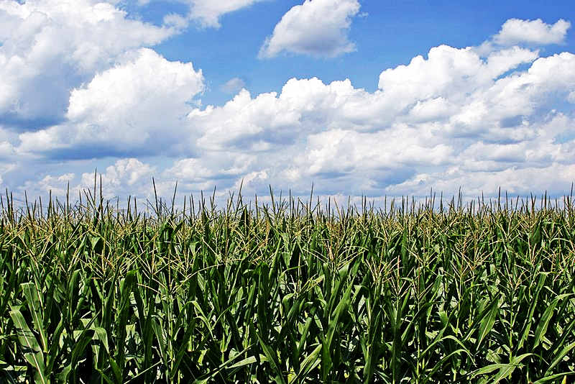
Project Management
Ben Collins

Slide 13
Successes!
Overall good team spirit and collaboration
Daily standups were useful for communication and accountability
Leaving buffers in the schedule helped for unexpected blockers
Slotted enough time for testing in the schedule
Resulted in multiple successful test runs & system iterations
Good Notion Management for tasking & documentation
Notes:
Tom

Slide 14
Lessons Learned
One PM encountered challenges in balancing technical and managerial responsibilities
Weekly task refinement
Sole POC for external stakeholders
Github maintainer
Communication with external stakeholders
System dependencies
Notes:
Shrudhi

Slide 15
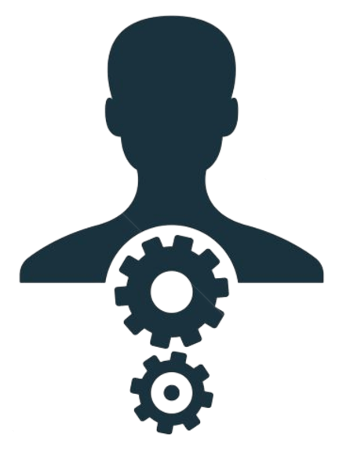
Lessons Learned
Project Manager
Manages overall schedule
Runs standups
Manages late cards
Runs weekly meetings
Communicates with stakeholders

Slide 16
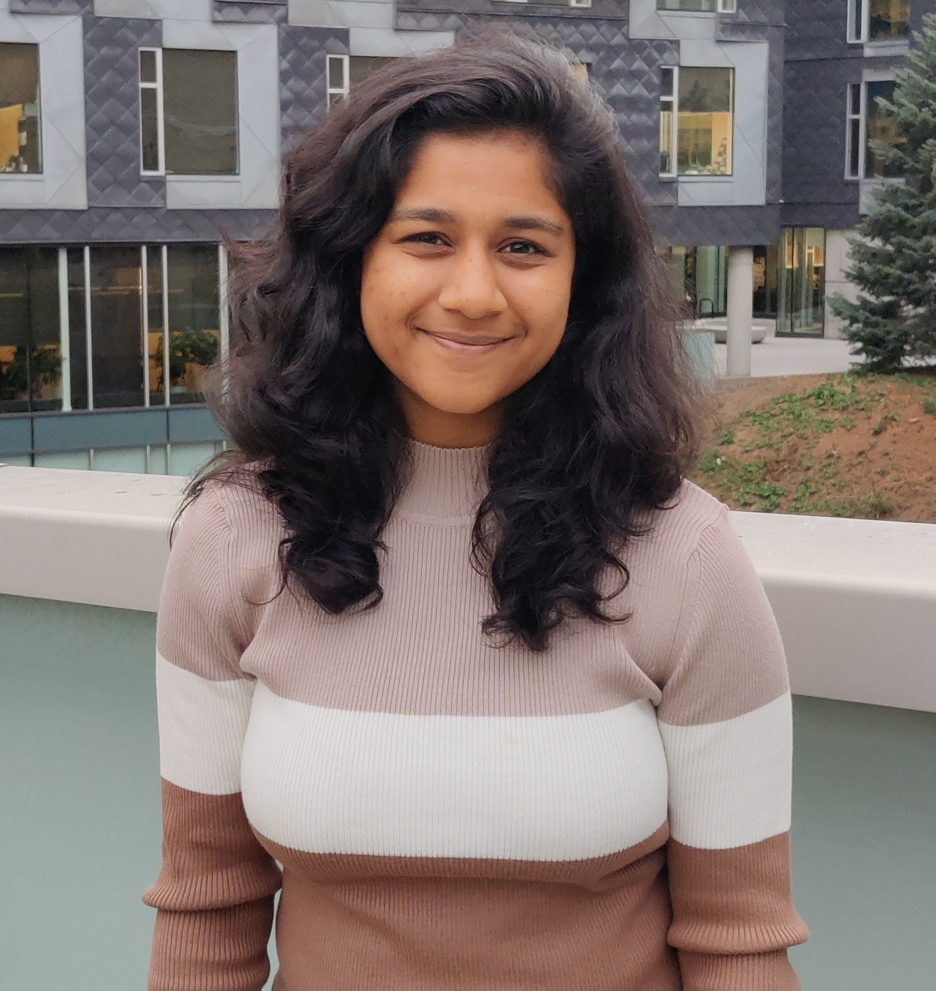
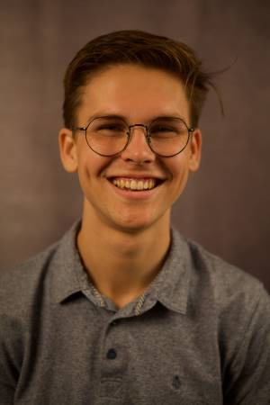
Lessons Learned
Project Manager
Big Picture Management
Manages overall schedule
Runs weekly meetings
Communicates with stakeholders
Co-Project Manager
Day-to-Day Management
Runs standups
Records meeting notes
Manages late cards

Slide 17
Lessons Learned
We had issues with …
External groups having the different goals and timelines
Hard to find an overlap for resource allocation
We will…
Be proactive about communication with other teams
Schedule weekly update/support meetings between teams
Make sure to reiterate our goals and deadlines
Stay informed about other teams’ goals and deadlines
Email/Slack regularly with other team members to close the loop
Notes:
Shrudhi

Slide 18
Tools & Methods
Weekly refinement meetings
Late card system
Daily Standups
Dev Flow change
Notes:
Shrudhi

Slide 19
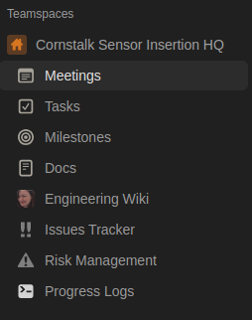
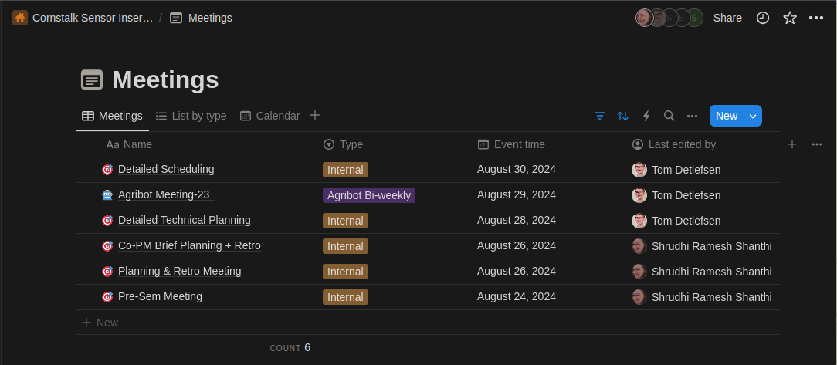
Tools & Methods
We love Notion!
Notes:
Shrudhi

Slide 20
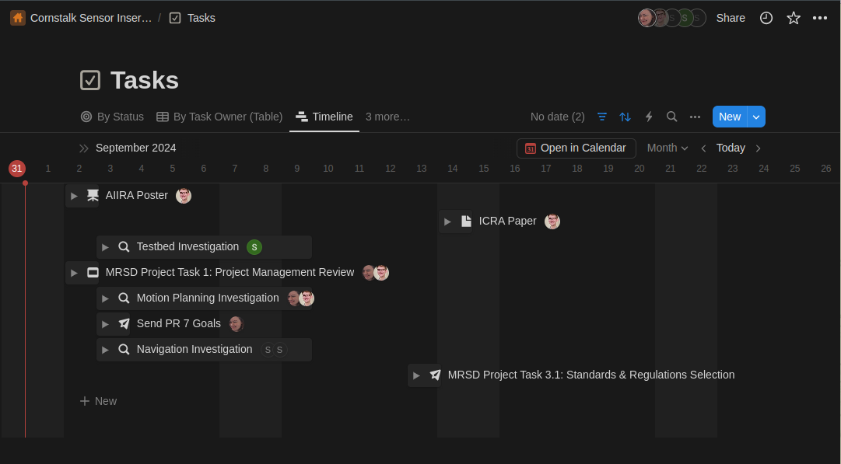
Tools & Methods
We love Notion!
Notes:
Shrudhi

Slide 21
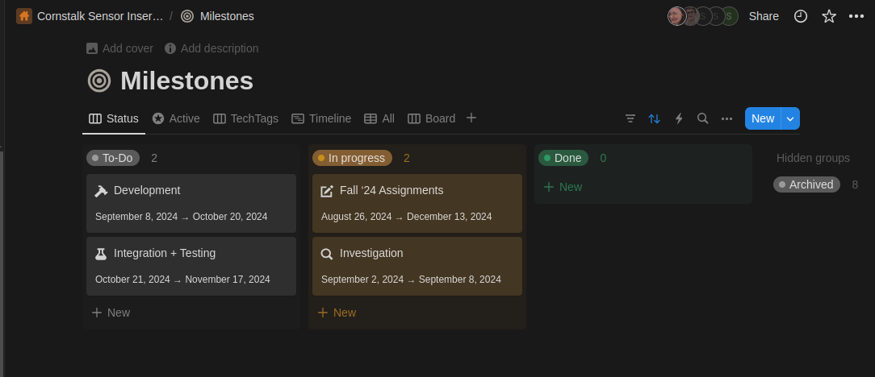
Tools & Methods
We love Notion!
Notes:
Shrudhi

Slide 22
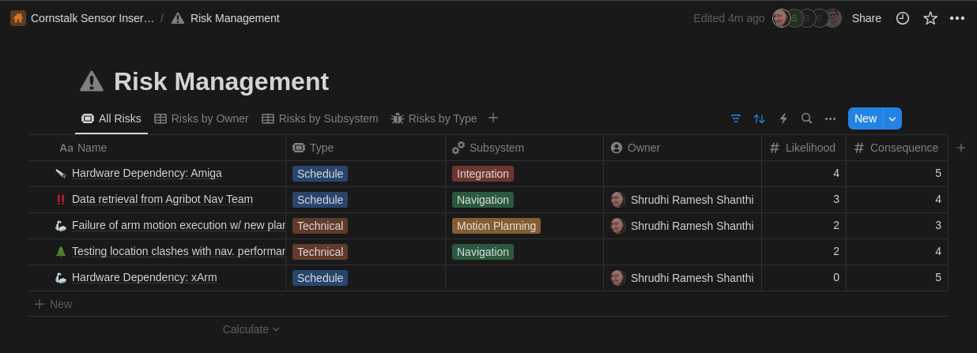
Tools & Methods
We love Notion!
Notes:
Shrudhi

Slide 23
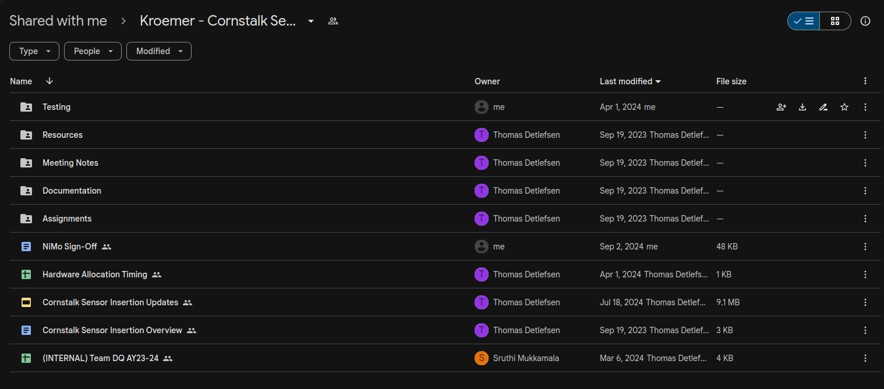
Tools & Methods
Google Drive
Notes:
Shrudhi

Slide 24
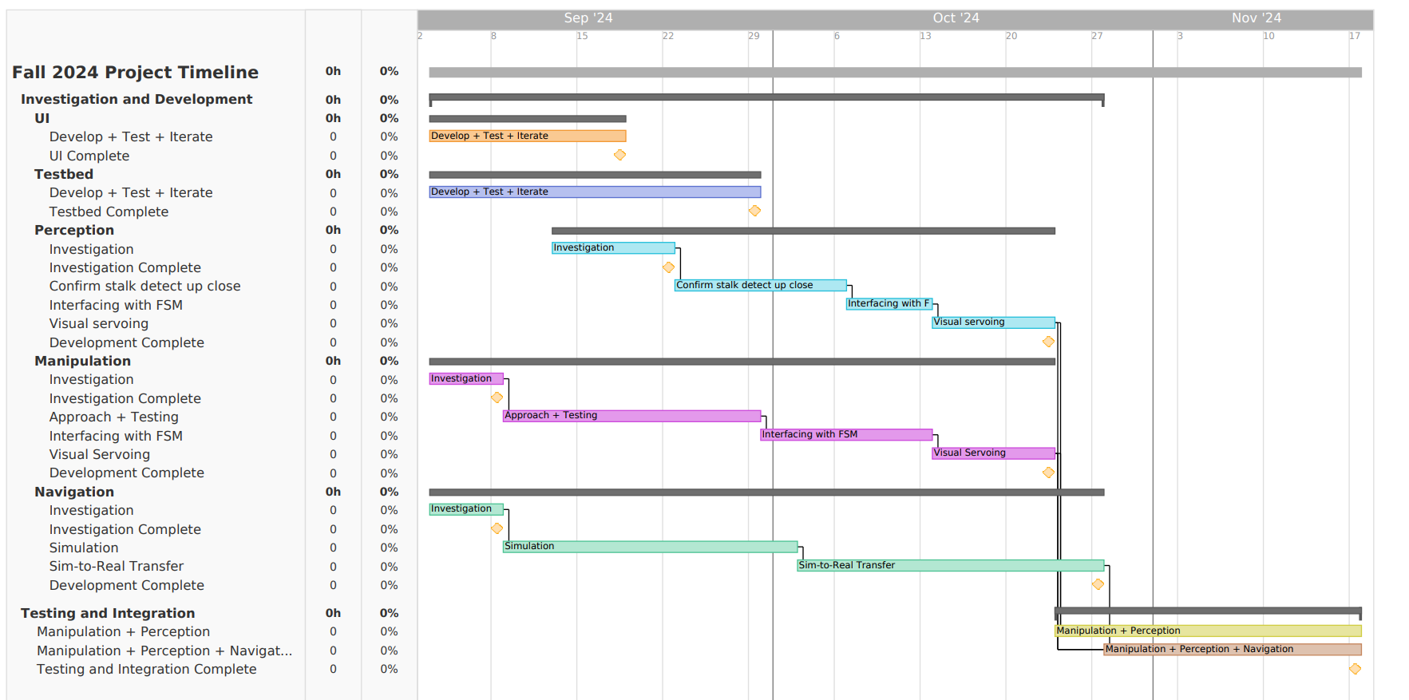
Schedule
Notes:
Shara

Slide 25
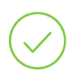
Schedule
Milestones
Development
Integration + Testing
9/18
11/15
Manipulation + Perception
UI Complete
9/29
11/15
Manipulation + Perception + Navigation
Testbed Complete
10/23
Perception Complete
11/17
Full system
10/23
Manipulation Complete
10/27
Navigation Complete
Notes:
Shara

Slide 26
Risks
Risk ID | Risk | Mitigation | Likelihood | Consequence
R1 | Hardware Dependency: xArm | As required, coordinate XArm work schedule with MSR counterpart Appropriately scope motion planning improvements (to target critical functionalities first) | 2 | 5
R2 | Hardware Dependency: Amiga | Work off Nav. team’s sim. until Amiga Base access on 10/1 (3.5 weeks into dev.) Prioritize completion of non-dependent subsystems (i.e., test bed & UI) Integrate non-dependent subsystems w/ UI | 4 | 5
R3 | Interteam Communication (Nav Team) | Involve more members of team (PM included) w/ communication CC stakeholders in communication | 3 | 4
Notes:
Sruthi

Slide 27
Risks
Risk ID | Risk | Mitigation | Likelihood | Consequence
R4 | Failure of arm motion execution w/ new planner | Confirm that two arm planners can be used simultaneously Appropriately scope and identify key functionalities that should be transferred first Develop rigid test plans to confirm new planner functionality before replacing on main branch | 2 | 4
R5 | Testing location clashes with nav. performance | Simplify problem to 1 row nav. Thoroughly brainstorm indoor vs. outdoor testing – choose option w/ less risk involved For indoor testing: Using Aruco Tags to localize the Amiga For outdoor testing: use GPS | 2 | 5
Notes:
Sruthi

Slide 28
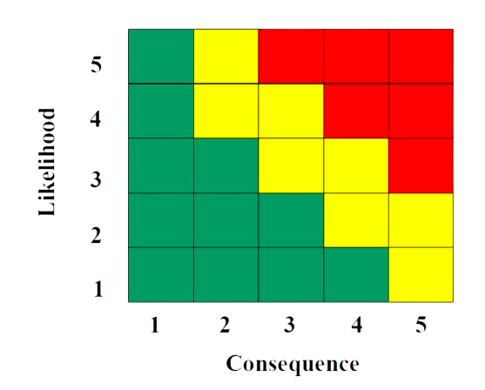
Risk Management
R1: Hardware Dependency - XArm
R2: Hardware Dependency - Amiga
R3: Interteam Communication
R4: Failure of arm motion execution w/ new planner
R5: Testing location clashes w/ Nav.
R2
Likelihood
R3
R5
R4
R1
Consequence
Notes:
Sruthi

Slide 29
Thanks!
Any questions/comments/corn-cerns?

